Slide 1



$$\vec{v}$$
$$B_{2}$$
$$B_{1}$$

Slide 2


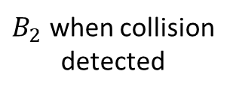
$$\vec{v}$$
$B_{2}$ when collision
detected
$$B_{1}$$
$$d$$
$B_{2}$ at TOI

Slide 3



$$\vec{v}$$
$B_{2}$ when collision
detected
$$\vec{c}$$
$$B_{1}$$
$$θ$$
$$d$$
$B_{2}$ at TOI
$$δ$$

Slide 4
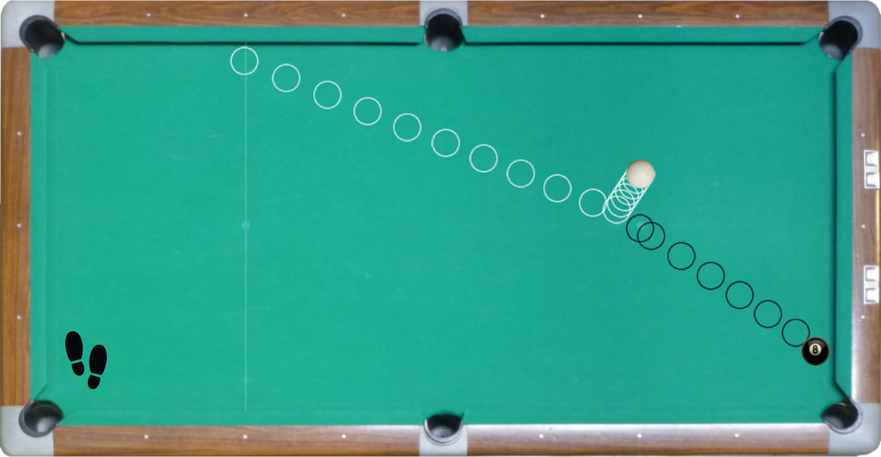
Line joining centers at TOI
Initial path of cue-ball
Tangent to balls at POI

Slide 5




$$B_{1}$$
$$\vec{u}$$
POI
$$\vec{v}$$
$$B_{2}$$
Notes:
Emphasize that we are finished talking about distance. Now we want to talk about computing the new velocity vectors after collision. So tell them to resent their brains here.
The primes on the green vector names are the velocities after collision. Here you see both before and after. Yes, these are different vectors than I’ve used up to now in the bug example. Get over it. “A foolish consistency is the hobgoblin of little minds” --- Emerson.

Slide 6



$$B_{1}$$
$$\hat{n}$$
$$B_{2}$$
Notes:
Here we see a tangent at the POI. It’s orthogonal to the line joining the balls’ centers. Hopefully I don’t need to define tangent; high school math has to teach them *something*!
Vector n-hat is the tangent normal which we get by subtracting the balls’ positions and normalizing (remind them what that is) .
It could point either way, but you need to get it right in code or your collisions will be backwards.
Your coding team should adopt a convention as to which way normals should point and stick to it!
Emphasize that the component of the balls’ velocity along the tangent is not changed by the collision. It’s only the component normal to the tangent that changes. We saw that in ball-wall and ball-line collision response.

Slide 7








$$B_{1}$$
$$B_{2}$$
$$B_{1}$$
$$B_{2}$$
$$v_{1}$$
$$v_{2}$$
$$v_{1}′$$
$$v_{2}′$$

Slide 8
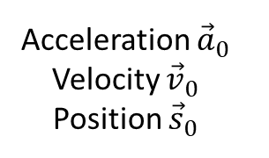

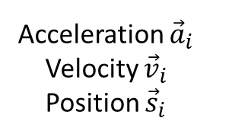

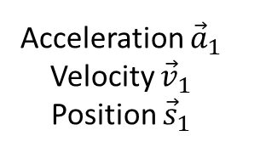



Acceleration ${\vec{a}}_{1}$
Velocity ${\vec{v}}_{1}$
Position ${\vec{s}}_{1}$
Acceleration ${\vec{a}}_{i}$
Velocity ${\vec{v}}_{i}$
Position ${\vec{s}}_{i}$
Frame:
0
1
2
$$⋯$$
$$i−1$$
$$i$$
$$i+1$$
$$Δt$$
Acceleration ${\vec{a}}_{0}$
Velocity ${\vec{v}}_{0}$
Position ${\vec{s}}_{0}$
Now
Notes:
Time is discrete. We only know where things are at discrete time slices. Riff on Heisenberg here if you wish. Yes, we can know both position and velocity.

Slide 9
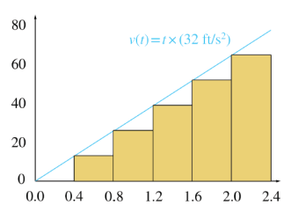
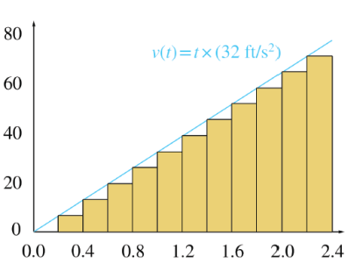
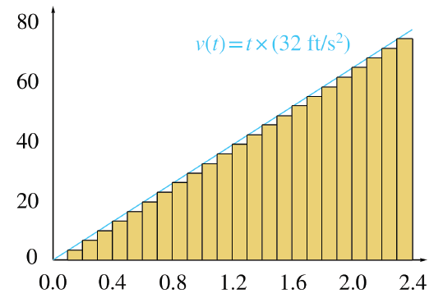
Notes:
Image at right from Wikimedia Commons.

